Slide 1
Chapter 7: Project Cost Management
Information Technology Project Management, Ninth Edition
Note: See the text itself for full citations

Slide 2
Learning Objectives (1 of 2)
Develop a justification for project cost management and its importance in achieving project success
Explain basic project cost management principles, concepts, and terms
Describe the process of planning cost management
Discuss different types of cost estimates and methods for preparing them
Using an example of an information technology (IT) project, list and describe the processes of determining a budget and preparing a cost estimate

Slide 3
Learning Objectives (2 of 2)
Justify the use of earned value management and project portfolio management to assist in cost control
Describe how project management software can assist in project cost management
Discuss considerations for agile/adaptive environments

Slide 4
The Importance of Project Cost Management
IT projects have a poor track record for meeting budget goals
Cost overrun is the additional percentage or dollar amount by which actual costs exceed estimates
A 2011 Harvard Business Review study reported an average cost overrun of 27 percent
Most important finding was the discovery of a large number of gigantic overages or “black swans”; a high-impact event that is rare and unpredictable, but not improbable in retrospect

Slide 5
What is Cost?
Cost is a resource sacrificed or foregone to achieve a specific objective or something given up in exchange
Usually measured in monetary units like dollars that must be paid to acquire goods and services

Slide 6
Learning Objectives
Project Cost Management is a method that uses technology to measure cost and productivity through the full life cycle of enterprise level projects
Understand the importance of project cost management
Explain basic project cost management principles, concepts, and terms
Describe the process of planning cost management
Discuss different types of cost estimates and methods for preparing them

Slide 7
Learning Objectives
Understand the processes of determining a budget and preparing a cost estimate for an information technology (IT) project
Understand the benefits of earned value management and project portfolio management to assist in cost control
Describe how project management software can assist in project cost management

Slide 8
The Importance of Project Cost Management
IT projects have a poor track record for meeting budget goals
A cost overrun is the additional percentage or dollar amount by which actual costs exceed estimates
A 2011 Harvard Business Review study reported an average cost overrun of 27 percent. The most important finding was the discovery of a large number of gigantic overages or “black swans”

Slide 9
Learning Objectives
Project Cost Management is a method that uses technology to measure cost and productivity through the full life cycle of enterprise level projects
Understand the importance of project cost management
Explain basic project cost management principles, concepts, and terms
Describe the process of planning cost management
Discuss different types of cost estimates and methods for preparing them

Slide 10
Learning Objectives
Understand the processes of determining a budget and preparing a cost estimate for an information technology (IT) project
Understand the benefits of earned value management and project portfolio management to assist in cost control
Describe how project management software can assist in project cost management

Slide 11
The Importance of Project Cost Management
IT projects have a poor track record for meeting budget goals
A cost overrun is the additional percentage or dollar amount by which actual costs exceed estimates
A 2011 Harvard Business Review study reported an average cost overrun of 27 percent. The most important finding was the discovery of a large number of gigantic overages or “black swans”

Slide 12
What Went Wrong?
The United Kingdom’s National Health Service IT modernization program was called the greatest IT disaster in history with an estimated $26 billion overrun
The program had problems due to incompatible systems, resistance from physicians, and arguments among contractors about who’s responsible for what
It was finally scrapped in 2011

Slide 13
What is Cost and Project Cost Management?
Cost is a resource sacrificed or foregone to achieve a specific objective or something given up in exchange
Costs are usually measured in monetary units like dollars
Project cost management includes the processes required to ensure that the project is completed within an approved budget
Project Managers: Make sure projects are
Well defined
Accurate time and cost estimates
Realistic budget
Satisfy shareholders
Reduce cost
et

Slide 14
Project Cost Management Processes:4 Proc.
Planning cost management :determining the policies, procedures, and documentation that will be used for planning, executing, and controlling project cost.
Estimating costs: developing an approximation or estimate of the costs of the resources needed to complete a project
Determining the budget: allocating the overall cost estimate to individual work items to establish a baseline for measuring performance
Controlling costs: controlling changes to the project budget (cost forecasts, asset update, change requests)

Slide 15
How Do We Manage Cost?
Processes
Planning cost management
Estimate Costs
Determine Budget
Control Costs
Planning cost management
Estimate
Costs
Determine Budget
Control
Costs

Slide 16
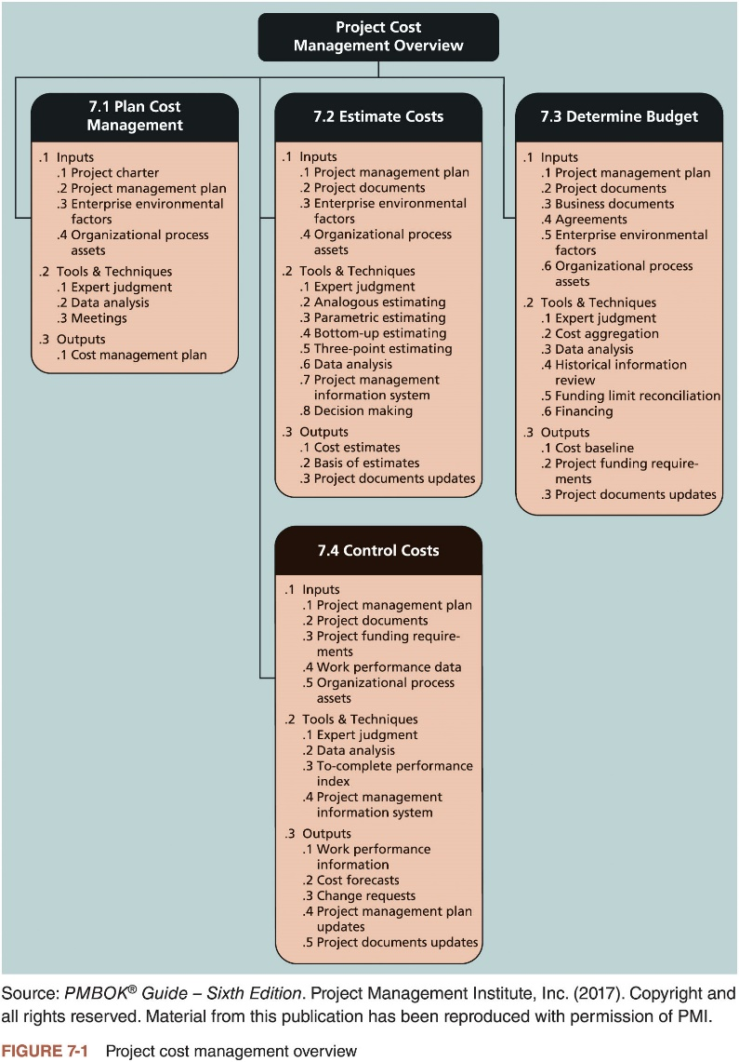
What is Project Cost Management? (2 of 2)

Slide 17
Basic Principles of Cost Management
Most members of an executive board better understand and are more interested in financial terms than IT terms , so IT project managers must speak their language
Profits are revenues minus expenditures
Profit margin is the ratio of revenues to profits
Life cycle costing considers the total cost of ownership, or development plus support costs, for a project
Cash flow analysis determines the estimated annual costs and benefits for a project and the resulting annual cash flow

Slide 18
Types of Costs and Benefits
Tangible costs or benefits are those costs or benefits that an organization can easily measure in dollars
Measure them accurately.
(hard cost) Cost you can “see feel and touch”. Ex: purchase cost of computer, power usage software purchase costs, wages, labor
Intangible costs or benefits are costs or benefits that are difficult to measure in monetary terms.
Cannot measure accurately
(soft costs). Costs cannot “see, feel or touch”. Ex. Productivity gains from computer use, sales gains from a better customer support, etc. (Employee moral)

Slide 19
Types of Costs and Benefits
Direct costs are costs that can be directly related to producing the products and services of the project. Produce goods or services (good sold, unsold), raw material, labor
Indirect costs are costs that are not directly related to the products or services of the project, but are indirectly related to performing the project.
Cost that affect the entire company, not just the product. Ex: advertising, depreciation, accounting services
Called overhead, nor related for making the product. In general, they are fixed. Ex. Pay the rent of the building or variables, pay the electricity, water bills
Sunk cost is money that has been spent in the past; when deciding what projects to invest in or continue, you should not include sunk costs.
Expenses have already occurred and can’t be changed or avoided or recovered.

Slide 20
More Basic Principles of Cost Management
Learning curve theory states that when many items are produced repetitively, the unit cost of those items decreases in a regular pattern as more units are produced
Reserves are dollars included in a cost estimate to mitigate cost risk by allowing for future situations that are difficult to predict
Contingency reserves allow for future situations that may be partially planned for (sometimes called known unknowns) and are included in the project cost baseline
Management reserves allow for future situations that are unpredictable (sometimes called unknown unknowns)

Slide 21
What is Project Cost Management? (1 of 2)
Project cost management includes the processes required to ensure that the project is completed within an approved budget
Planning cost management: determining the policies, procedures, and documentation that will be used for planning, executing, and controlling project cost
Estimating costs: developing an approximation or estimate of the costs of the resources needed to complete a project
Determining the budget: allocating the overall cost estimate to individual work items to establish a baseline for measuring performance
Controlling costs: controlling changes to the project budget

Slide 22
Basic Principles of Cost Management (1 of 3)
Most members of an executive board better understand and are more interested in financial terms than IT terms; they need to be able to present and discuss project information in both
Profits: revenues minus expenditures
Profit margin: ratio of profits to revenues
Life cycle costing: considers total cost of ownership, or development plus support costs, for a project
Cash flow analysis: determines estimated annual costs and benefits for a project and resulting annual cash flow

Slide 23
Basic Principles of Cost Management (2 of 3)
Types of costs and benefits
Tangible costs or benefits are those costs or benefits that an organization can easily measure in dollars
Intangible costs or benefits are costs or benefits that are difficult to measure in monetary terms
Direct costs are costs that can be directly related to producing the products and services of the project
Indirect costs are costs that are not directly related to the products or services of the project, but are indirectly related to performing the project
Sunk cost is money that has been spent in the past; when deciding what projects to invest in or continue, you should not include sunk costs

Slide 24
Basic Principles of Cost Management (3 of 3)
Additional concepts
Learning curve theory states that when many items are produced repetitively, the unit cost of those items decreases in a regular pattern as more units are produced
Reserves are dollars included in a cost estimate to mitigate cost risk by allowing for future situations that are difficult to predict
Contingency reserves allow for future situations that may be partially planned for (sometimes called known unknowns) and are included in the project cost baseline
Management reserves allow for future situations that are unpredictable (sometimes called unknown unknowns)

Slide 25
Planning Cost Management
The first step in project cost management is planning how the costs will be managed throughout the life of the project
The project team uses expert judgment, analytical techniques, and meetings to develop the cost management plan
Cost management plan includes:
Level of accuracy
Units of measure
Organizational procedure links
Control thresholds
Rules of performance measurement
Reporting formats
Process descriptions

Slide 26
Estimating Costs (1 of 4)
Project managers must take cost estimates seriously if they want to complete projects within budget constraints
Types of cost estimates
Tools and techniques for estimating costs
Typical problems associated with IT cost estimates

Slide 27
Estimating Costs (2 of 4)
Type of Estimate | When Done | Why Done | Typical Range
Rough order of magnitude (ROM) | Very early in the project life cycle, often 3–5 years before project completion | Provides estimate of cost for selection decisions | -50% to + 100%
Budgetary | Early, 1–2 years out | Puts dollars in the budget plans | -10% to +25%
Definitive | Later in the project, less than 1 year out | Puts dollars in the budget plans | -5% to +10%
Table 7-1 Types of cost estimates

Slide 28
Estimating Costs (3 of 4)
The number and type of cost estimates vary by application area
The Association for the Advancement of Cost Engineering International identifies five types of cost estimates for construction projects
Order of magnitude, conceptual, preliminary, definitive, and control
Estimates are usually done at various stages of a project
Should become more accurate as time progresses
It is important to provide supporting details for estimates and updates to project documents
A large percentage of total project costs are often labor costs

Slide 29
Estimating Costs (4 of 4)
Department | Year 1 | Year 2 | Year 3 | Year 4 | Year 5 | Totals
Information systems | 24 | 31 | 35 | 13 | 13 | 116
Marketing systems | 3 | 3 | 3 | 3 | 3 | 15
Reservations | 12 | 29 | 33 | 9 | 7 | 90
Contractors | 2 | 3 | 1 | 0 | 0 | 6
Totals | 41 | 66 | 72 | 25 | 23 | 227
Table 7-2 Maximum FTE by department by year

Slide 30
Cost Estimation Tools and Techniques
Analogous or top-down estimates
Use the actual cost of a previous, similar project as the basis for estimating the cost of the current project
Bottom-up estimates
Involve estimating individual work items or activities and summing them to get a project total
Three-point estimates
Involve estimating the most likely, optimistic, and pessimistic costs for items
Parametric estimating
Uses project characteristics (parameters) in a mathematical model to estimate project costs

Slide 31
Typical Problems with IT Cost Estimates
Reasons for inaccuracies
Estimates are done too quickly
People lack estimating experience
Human beings are biased toward underestimation
Management desires accuracy

Slide 32
How to Develop a Cost Estimate and Basis of Estimates (1 of 3)
See the text for a detailed example of creating a cost estimate for the Surveyor Pro project described in the opening case
Before creating an estimate gather as much information as possible about the project, ask how the organization plans to use the cost estimate, and clarify the ground rules and assumptions

Slide 33
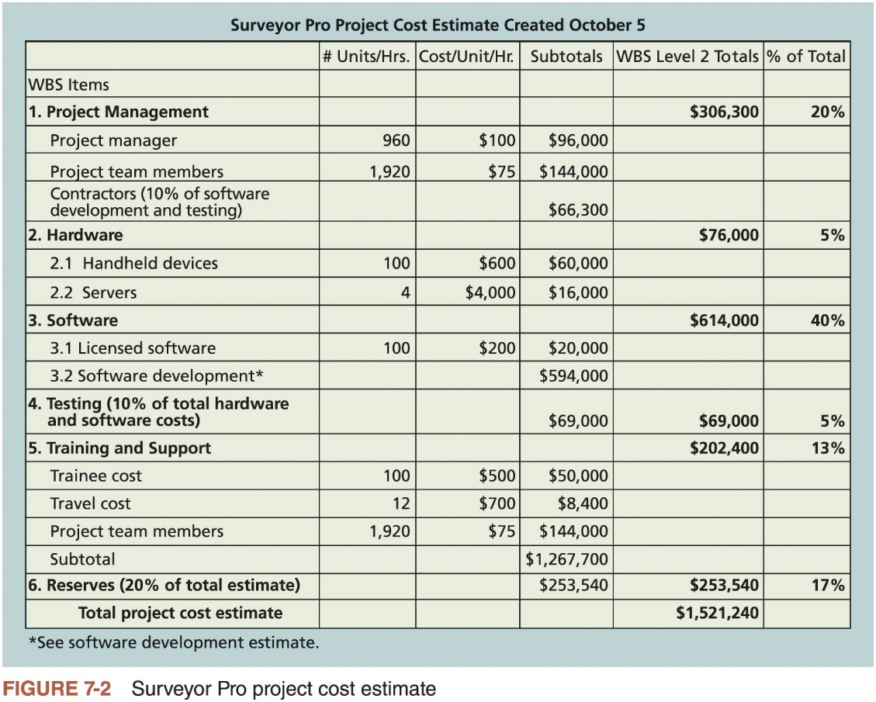
How to Develop a Cost Estimate and Basis of Estimates (2 of 3)
Notes:
.

Slide 34
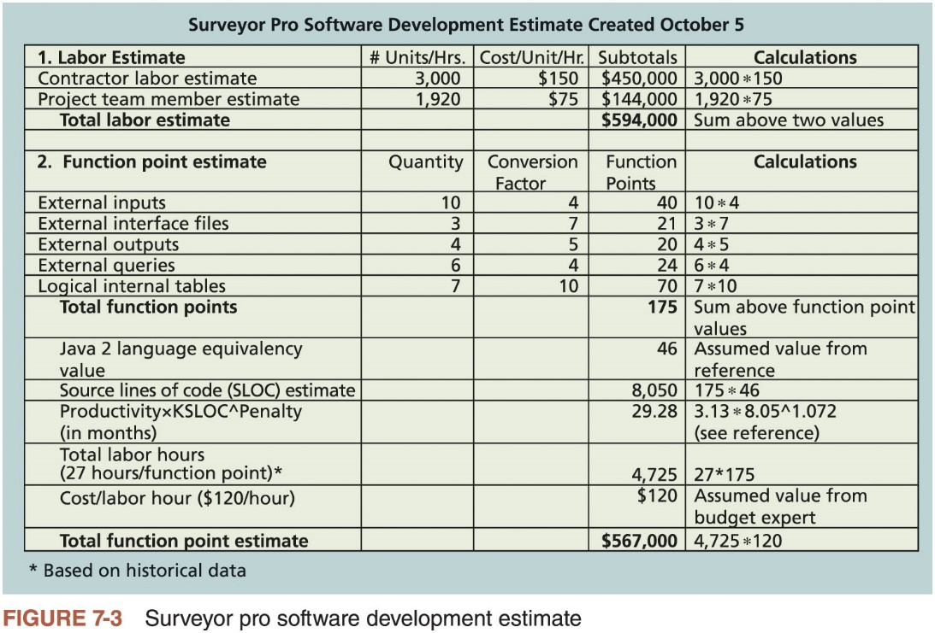
How to Develop a Cost Estimate and Basis of Estimates (3 of 3)

Slide 35
Determining the Budget (1 of 2)
Budgeting involves allocating the project cost estimate to individual work items over time
Material resources or work items are based on the activities in the WBS for the project
Important goal is to produce a cost baseline
Time-phased budget that project managers use to measure and monitor cost performance

Slide 36
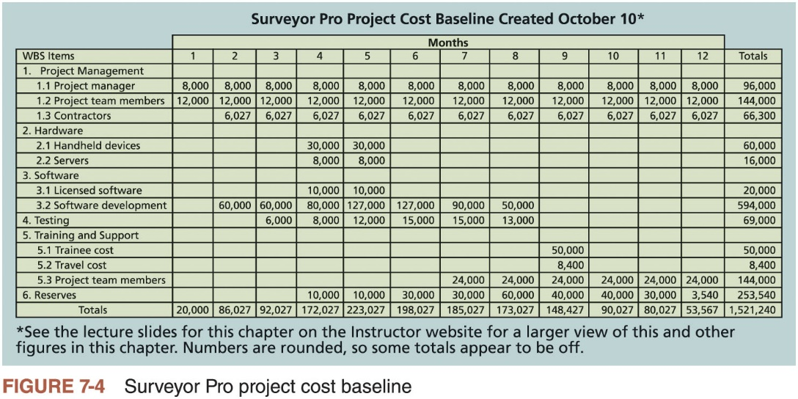
Determining the Budget (2 of 2)

Slide 37
Controlling Costs
Activities involved in controlling project costs
Monitoring cost performance
Ensuring that only appropriate project changes are included in a revised cost baseline
Informing project stakeholders of authorized changes to the project that will affect costs
Several tools and techniques assist in project cost control
Expert judgment, data analysis, project management information systems, and the to-complete performance index

Slide 38
Earned Value Management (EVM) (1 of 5)
Project performance measurement technique that integrates scope, time, and cost data
Given a baseline (original plan plus approved changes), you can determine how well the project is meeting scope, time, and cost goals
Earned value management involves calculating three values for each activity or summary activity from a project’s WBS
Planned value
Actual cost
Earned value

Slide 39
Earned Value Management (EVM) (2 of 5)
Activity | Week 1
Earned value (EV) | 5,000
Planned value (PV) | 10,000
Actual cost (AC) | 15,000
Cost variance (CV) | -10,000
Schedule variance (SV) | -5,000
Cost performance index (CPI) | 33%
Schedule performance index (SPI) | 50%
Table 7-3 Earned value calculations for one activity after week 1

Slide 40
Earned Value Management (EVM) (3 of 5)
Term | Formula
Earned value (EV) | EV = PV of all completed work
Cost variance (CV) | CV = EV - AC
Schedule variance (SV) | SV = EV - PV
Cost performance index (CPI) | CPI = EV/AC
Schedule performance index (SPI) | SPI = EV/PV
Estimate at completion (EAC) | EAC = BAC/CPI
Estimated to Complete (ETC) | ETC = EAC - AC
Table 7-4 Earned value formulas

Slide 41
Earned Value Management (EVM) (4 of 5)
Important concepts
Cost variance (CV) is the earned value minus the actual cost
Schedule variance (SV) is the earned value minus the planned value
Cost performance index (CPI) is the ratio of earned value to actual cost
Schedule performance index (SPI) is the ratio of earned value to planned value
Estimate at completion (EAC) is an estimated cost of completing a project based on performance to date
To-complete performance index (TCPI) is a measure of the cost performance that must be achieved with the remaining resources to meet a specific goal

Slide 42
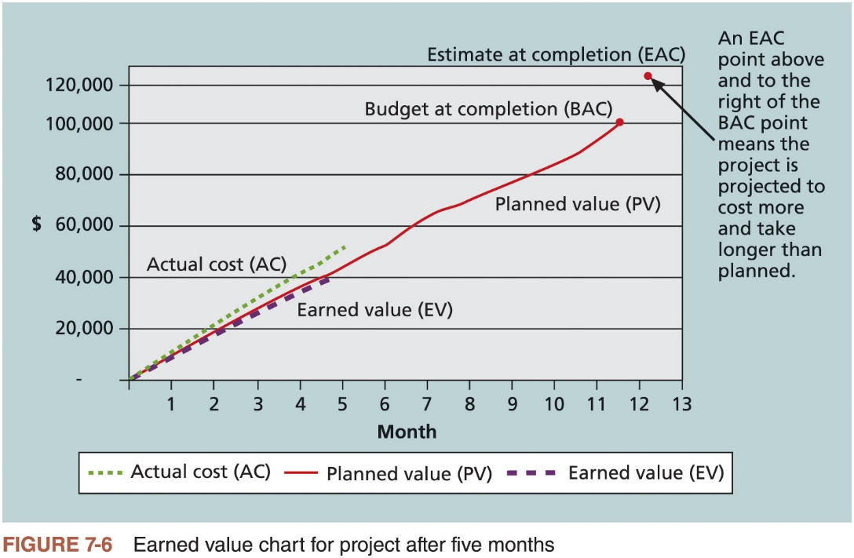
Earned Value Management (EVM) (5 of 5)

Slide 43
Global Issues (1 of 2)
EVM is used worldwide, and it is particularly popular in the Middle East, South Asia, Canada, and Europe
Most countries require EVM for large defense or government projects, as shown in Figure 7-7
EVM is also used in such private-industry sectors as IT, construction, energy, and manufacturing.
However, most private companies have not yet applied EVM to their projects because management does not require it, feeling it is too complex and not cost effective

Slide 44
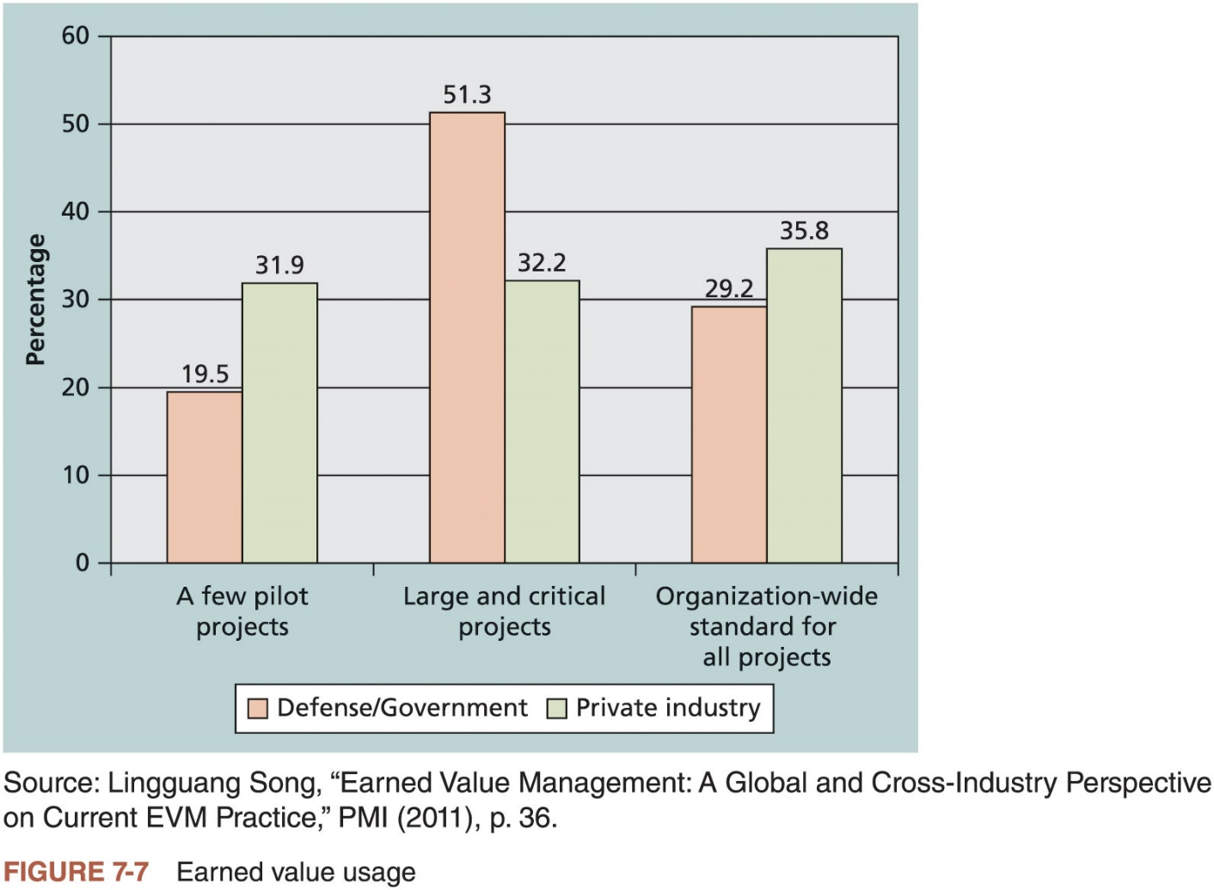
Global Issues (2 of 2)

Slide 45
Project Portfolio Management
Many organizations collect and control an entire suite of projects or investments as one set of interrelated activities in a portfolio
Five levels for project portfolio management
Put all your projects in one database
Prioritize the projects in your database
Divide your projects into two or three budgets based on type of investment
Automate the repository
Apply modern portfolio theory, including risk-return tools that map project risk on a curve

Slide 46
Using Project Management Software to Assist in Project Cost Management (1 of 2)
Spreadsheets are a common tool for resource planning, cost estimating, cost budgeting, and cost control
Many companies use more sophisticated and centralized financial applications software for cost information
Project management software can increase a project manager’s effectiveness during each process of project cost management
Many IT project managers use other tools to manage cost information because they do not know that they can use project management software, or they do not track costs based on a WBS, as most project management software does

Slide 47
Using Project Management Software to Assist in Project Cost Management (2 of 2)
Recent Studies on PPM Software
2017 Gartner report says the market continues to grow, with annual sales over $2.3 billion
Forrester estimates ROIs of 250 percent from PPM tools
Pfizer and Ford use PPM software to improve transparency of the many projects they manage

Slide 48
Considerations for Agile/Adaptive Environments
AgileEVM is an adapted implementation of EVM
Uses the Scrum framework artifacts as inputs, uses traditional EVM calculations, and is expressed in traditional EVM metrics
Requires a minimal set of input parameters
Actual cost of a project, an estimated product backlog, a release plan that provides information on the number of iterations in the release and the assumed velocity
All estimates can be in hours, story-points, team days or any other consistent estimate of size
The critical factor is that it must be a numerical estimate of some kind

Slide 49
Chapter Summary
Project cost management is a traditionally weak area of IT projects
Project managers must understand several basic principles of cost management to be effective in managing project costs
Main processes
Plan cost management
Estimate costs
Determine the budget
Control costs
Several software products can assist with project cost management

